Slide 1
Metal Forming: The Basic Concepts
Lecture 13

Slide 2
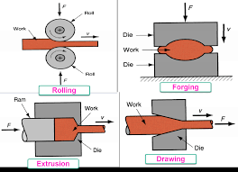
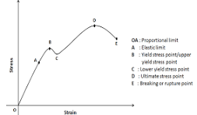
Metal Forming Process
Metal Forming Process: A Fabrication process in which parts/components are produced by subjecting the material to heavy plastic deformation.

Slide 3
Different Metal Forming Processes

Slide 4
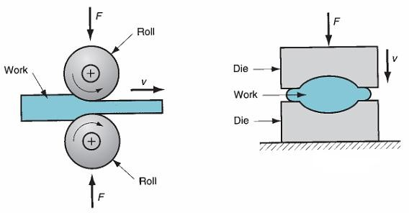
Bulk Forming Processes (1)
Bulk forming: It is a severe deformation process that results in a significant shape change.
The surface area-to-volume ratio of the work is relatively small. Mostly done in hot working conditions.
Rolling: In this process, the workpiece in the form of a slab or plate is compressed between two rotating rolls in the thickness direction, so that the thickness is reduced. The rotating rolls draw the slab into the gap and compress it. The final product is in the form of a sheet.
Forging: The workpiece is compressed between two dies containing shaped contours. The die shapes are imparted to the final part.
Forging
Rolling

Slide 5
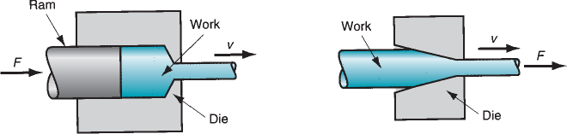
Bulk Forming Processes (2)
Extrusion: In this, the workpiece is compressed or pushed into the die opening to take the shape of the die hole as its cross-section.
Wire or rod drawing: similar to extrusion, except that the workpiece is pulled through the die opening to take the cross-section.
Wire drawing
Extrusion

Slide 6
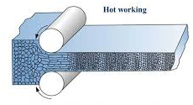
Bulk Forming Processes: Hot Working and Cold Working
Hot Working Processes:
The bulk deformation process occurs above the recrystallization temperature.
Strength and hardness decrease because of recrystallization
The deformation process is carried out at a higher temperature, but lower than the melting temperature (0.5 T_{m} to 0.75 T_{m})
New crystals are formed due to recrystallization, which are strain-free
No residual stresses.
Surface finish is not good.
Less force is required.

Slide 7
Hot Working Processes:
Advantages:
(1) significant plastic deformation can be given to the sample,
(2) significant change in workpiece shape,
(3) lower forces are required,
(4) materials with premature failure can be hot formed,
(5) absence of strengthening due to work hardening.
Disadvantages:
shorter tool life,
poor surface finish,
lower dimensional accuracy,
sample surface oxidation

Slide 8
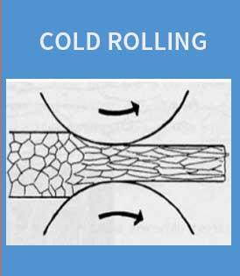
Cold Working Processes:
The bulk deformation process occurs below the recrystallization temperature.
Strain hardening leads to an increase in strength and hardness.
Ductility decreases.
Internal/residual stresses set up in the material.
No new crystal forms.
Surface finish can be achieved.
More force and power are required.

Slide 9
Worm Working Process
In this case, forming is performed at temperatures just above room temperature but below the recrystallization temperature.
The working temperature is taken to be 0.3 T_{m,} where T_{m} is the melting point of the workpiece.
Advantages:
(1) Enhanced plastic deformation properties,
(2) Lower forces required,
(3) Intricate work geometries are possible,
(4) Annealing stages can be reduced.

Slide 10
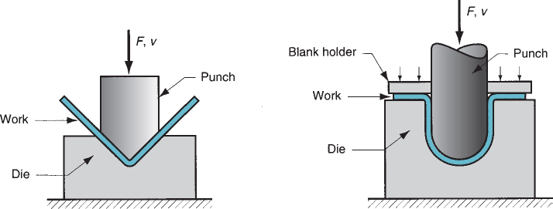
Sheet Metal Forming Processes (1)
Sheet metal forming involves forming and cutting operations performed on metal sheets, strips, and coils.
The surface area-to-volume ratio of the starting metal is relatively high.
Punches and dies are used as tools to deform the sheets.
Bending: The sheet material is strained by a punch to give a bend shape (angle shape) usually in a straight axis.
Bending

Slide 11
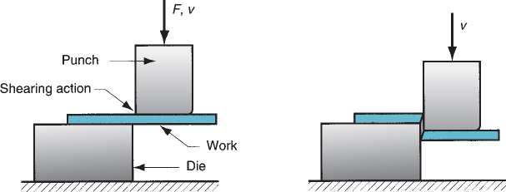
Sheet Metal Forming Processes (2)
Deep (or cup) drawing: Forming a flat metal sheet into a hollow or concave shape, such as a cup, is achieved by stretching the metal in specific regions.
A blank holder is used to clamp the blank against the die, while the punch pushes into the sheet metal. The sheet is drawn into the die hole, taking the shape of the cavity.
Shearing: Cutting of sheets by shearing action.
Deep drawing
shearing

Slide 12


